Slide 1
Basic Definitions:
DES (Data Encryption Standard)
Symmetric encryption algorithm (same key for encryption and decryption).
Uses 56-bit key – considered insecure today.
Vulnerable to brute-force attacks (can be cracked in hours or minutes with modern hardware).
AES (Advanced Encryption Standard)
Also symmetric.
Can use 128, 192, or 256-bit keys.
Chosen by the U.S. government and widely used in industry.
Much more secure and efficient than DES.

Slide 2
How They Work (Simplified):
DES:
Splits data into 64-bit blocks.
Runs 16 rounds of complex operations (permutations, substitutions, XOR with key).
Based on a Feistel network (input is split and each half feeds into the other).
AES:
Operates on 128-bit blocks.
Applies multiple rounds (10, 12, or 14 depending on key size).
Each round involves:
SubBytes (substitution)
ShiftRows (row shifting)
MixColumns (mixing data)
AddRoundKey (XOR with round key)
Not a Feistel network — more modern design.

Slide 3
Real-Life Use:
DES: Historical interest, no longer recommended.
AES: Used in Wi-Fi encryption (WPA2/WPA3), VPNs, disk encryption (BitLocker), messaging app.

Slide 4
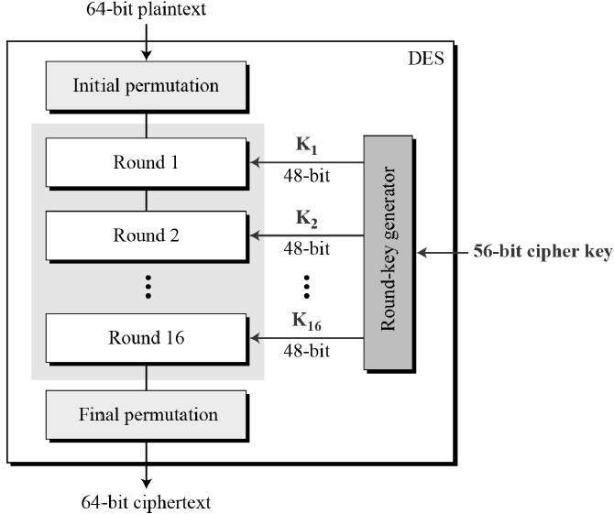
Data Encryption Standard
The Data Encryption Standard (DES) is a symmetric-key block cipher published by the National Institute of Standards and Technology (NIST).
DES is an implementation of a Feistel Cipher. It uses 16 round Feistel structure. The block size is 64-bit. Though, key length is 64-bit, DES has an effective key length of 56 bits, since 8 of the 64 bits of the key are not used by the encryption algorithm (function as check bits only).

Slide 5
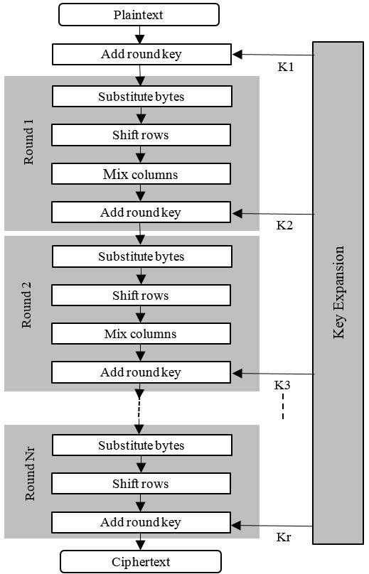
Advanced Encryption Standard
AES is an iterative rather than Feistel cipher. It is based on ‘substitution–permutation network’. It comprises of a series of linked operations, some of which involve replacing inputs by specific outputs (substitutions) and others involve shuffling bits around (permutations).
Interestingly, AES performs all its computations on bytes rather than bits. Hence, AES treats the 128 bits of a plaintext block as 16 bytes. These 16 bytes are arranged in four columns and four rows for processing as a matrix.
Unlike DES, the number of rounds in AES is variable and depends on the length of the key. AES uses 10 rounds for 128-bit keys, 12 rounds for 192-bit keys and 14 rounds for 256-bit keys. Each of these rounds uses a different 128-bit round key, which is calculated from the original AES key.

Slide 6
Secret Key (Key)
A required part of AES.
It’s the main secret used to encrypt and decrypt the data.
AES supports key sizes of 128, 192, or 256 bits.
Must be kept secret – if someone has it, they can decrypt your data.
Example:
128-bit key = 16 bytes
b"mysecretkey12345" (16 characters)

Slide 7
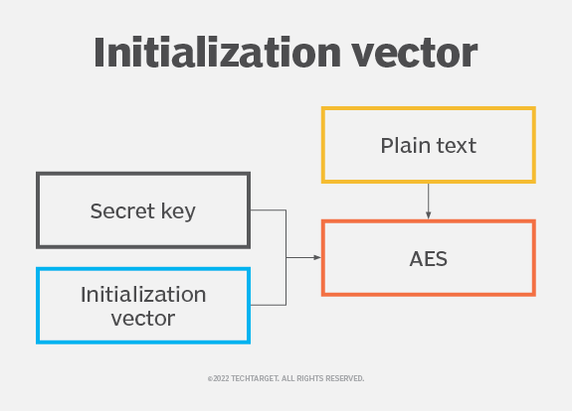
IV (Initialization Vector)
Used only in some AES modes (like CBC, CFB, OFB).
The IV is not secret, but it must be unique and random for each encryption.
Purpose: To ensure different ciphertexts even when encrypting the same plaintext with the same key.
IV is usually the same size as the AES block size (16 bytes for AES).
IV is sent along with the ciphertext so the receiver can decrypt correctly.

Slide 8
Analogy + Final Notes:
Analogy:
Secret key = your password
IV = a random salt or number added to avoid repetition
Together, they make encryption secure and unpredictable
Final Notes:
Key = secret and shared securely between sender/receiver
IV = not secret, but must be unique per encryption session
Reusing an IV with the same key can break encryption security

Slide 9
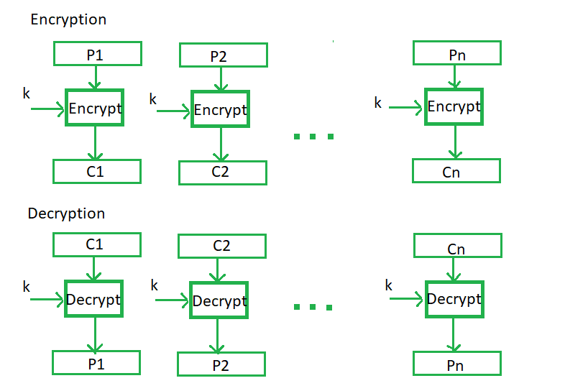
Electronic Code Book (ECB)
Electronic code book is the easiest block cipher mode of functioning. It is easier because of direct encryption of each block of input plaintext and output is in form of blocks of encrypted ciphertext. Generally, if a message is larger than b bits in size, it can be broken down into a bunch of blocks and the procedure is repeated.

Slide 10
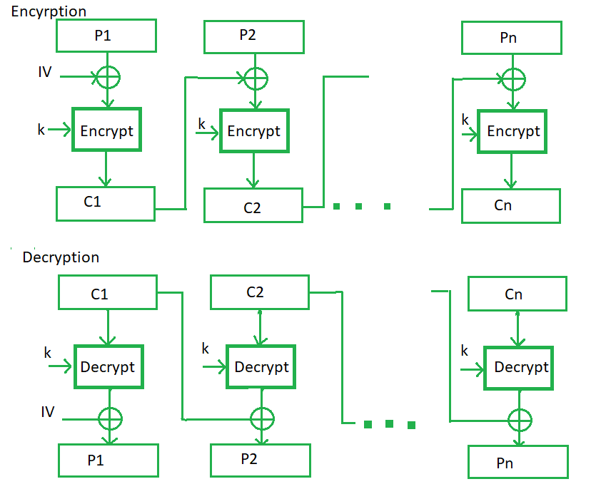
Cipher Block Chaining (CBC)
Cipher block chaining or CBC is an advancement made on ECB since ECB compromises some security requirements. In CBC, the previous cipher block is given as input to the next encryption algorithm after XOR with the original plaintext block. In a nutshell here, a cipher block is produced by encrypting an XOR output of the previous cipher block and present plaintext block.

Slide 11
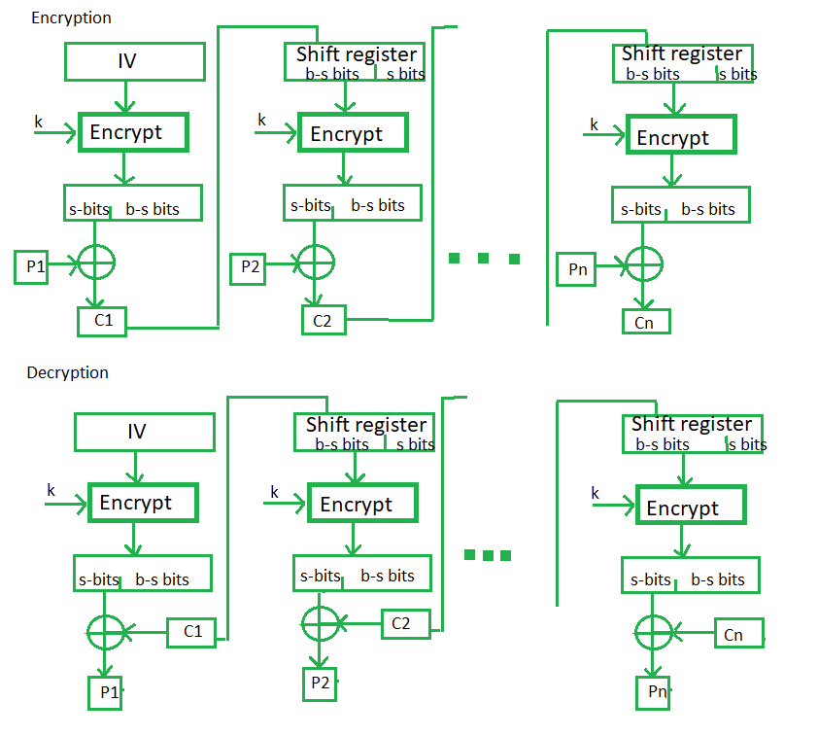
Cipher Feedback Mode (CFB)
In this mode the cipher is given as feedback to the next block of encryption with some new specifications: first, an initial vector IV is used for first encryption and output bits are divided as a set of s and b-s bits.
The left-hand side s bits are selected along with plaintext bits to which an XOR operation is applied. The result is given as input to a shift register having b-s bits to lhs, s-bits to rhs and the process continues.
The encryption and decryption process for the same is shown below, both use encryption algorithms.

Slide 12
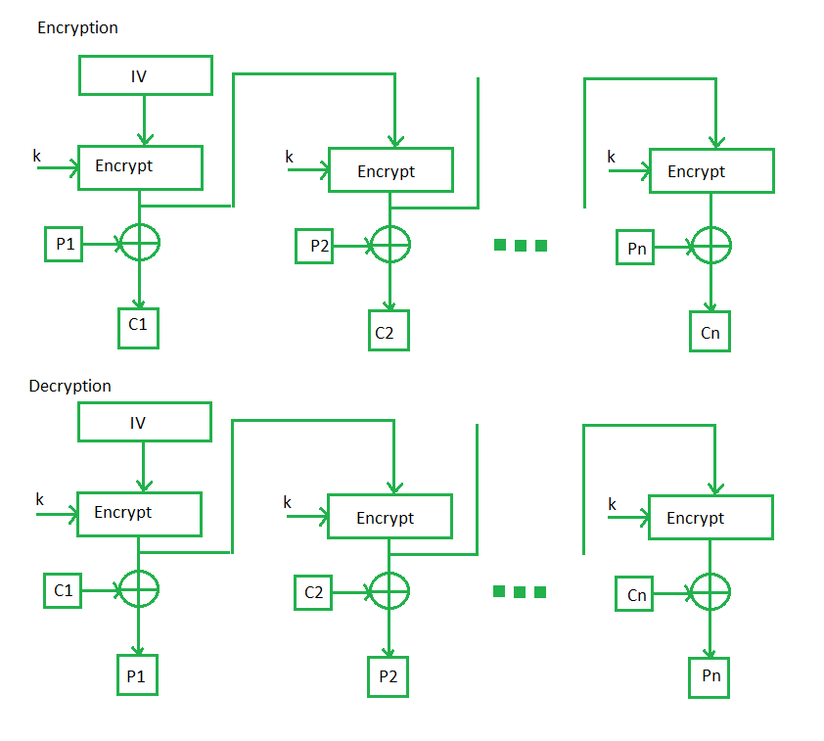
Output Feedback Mode (OFB)
The output feedback mode follows nearly the same process as the Cipher Feedback mode except that it sends the encrypted output as feedback instead of the actual cipher which is XOR output.
In this output feedback mode, all bits of the block are sent instead of sending selected s bits.
The Output Feedback mode of block cipher holds great resistance towards bit transmission errors. It also decreases the dependency or relationship of the cipher on the plaintext.

Slide 13
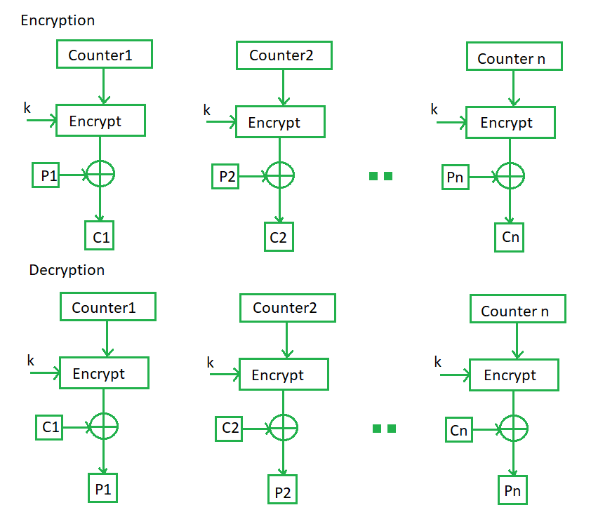
Counter Mode (CTR)
The Counter Mode or CTR is a simple counter-based block cipher implementation. Every time a counter-initiated value is encrypted and given as input to XOR with plaintext which results in ciphertext block.
The CTR mode is independent of feedback use and thus can be implemented in parallel.

